Slide 1
Binary Tree 1. CreateBT (recursive) and insert a new node (Iterative)
2. iterativePreorder 3. iterativeinorder 4. Iterative level_order 5. copy 6. printAncestors 7. parent 8. Height of a tree

Slide 2
Creating BT in recursive manner
treenode *createBT()
{
treenode *p;
int x;
cout<<"Enter data(-1 for no data):";
cin>>x;
if(x==-1)
return NULL;
p=new tree_node;
p->data=x;
cout<<"Enter left child of “<<x<<“:”;
p->lc=createBT();
cout<<"Enter right child of “<<x<<“:”;
p->rc=createBT();
return p;
}
Binary tree creation using recursive method.
Enter data(-1 for no data):5 Enter left child of 5: Enter data(-1 for no data):7 Enter left child of 7: Enter data(-1 for no data):8 Enter left child of 8: Enter data(-1 for no data):3 Enter left child of 3: Enter data(-1 for no data):-1 Enter right child of 3: Enter data(-1 for no data):-1 Enter right child of 8: Enter data(-1 for no data):-1 Enter right child of 7: Enter data(-1 for no data):-1 Enter right child of 5: Enter data(-1 for no data):-1
Calling create function in main
root=createBT();

Slide 3
class treenode
{
treenode* leftchild; int data; treenode* rightchild;
public:
treenode(int element=0)
{
data=element; leftchild=NULL; rightchild=NULL;
}
treenode* insert(int,treenode*);
void iterativePreorder(tree_node*);
void iterativeinorder(tree_node *);
void level_order(treenode* ptr);
treenode *copy(treenode *ptr);
int treenode::printAncestors(treenode *root, int target)
treenode* parent(treenode *,int ele);
int treenode::depth(treenode *ptr);
};
treenode* root=NULL;
1. insert

Slide 4
treenode *treenode::insert(int item,treenode* root)
{
treenode* temp=new treenode(item);
if(root==NULL)
{ root=temp; return root; }
char direction[20];
cout<<"enter direction in uppercase: “; cin>>direction;
treenode* current; treenode* prev; //parent of new node
prev=NULL; current=root;
int i;
for(i=0;i<direction[i]!=‘\0’&&current!=NULL;i++)
{
prev=current;
if(direction[i]=='L’) current=current->leftchild;
else current=current->rightchild;
}
1. insert

Slide 5
1. insert
if(current!=NULL||direction[i]!=‘\0’)
{
cout<<"insertion not possible";
delete temp;
return root;
}
if(direction[i-1]=='L')
prev->leftchild=temp;
else
prev->rightchild=temp;
return root;
}

Slide 6
2. Iterative Preorder traversal algorithm
1. Create an empty stack nodeStack and push root node to stack
2. Do following while nodeStack is not empty
a. Pop an item from stack and print it. b. Push right child of popped item to stack c. Push left child of popped item to stack

Slide 7
// An iterative process to print preorder traversal of Binary tree
void treenode::iterativePreorder(Node *root)
{
// Base Case
if (root == NULL) return;
Node* curr=root; // 1. Create an empty stack and push root to it
Node* s1[10]; int top=-1;
s1[++top]=root;
for(;;) {
if (top>=0) curr=s1[top--]; //a. Pop an item from stack and print it.
else curr=NULL;
if(curr==NULL) break; //2. Do following while nodeStack is not empty
cout<<curr->data; //a. Pop an item from stack and print it.
if (curr->rc) s1[++top]=curr->rc; //b. Push right child of popped item to stack
if (curr->lc) s1[++top]=curr->lc; //c. Push left child of popped item to stack
}
}
2. Iterative Preorder

Slide 8
Iterative inorder traversal
3. Iterative inorder
1) Create an empty stack S.
2) Initialize current node as root
3) Push the current node to S if not NULL and set current = current->left until current becomes NULL(repeat)
4) If stack is not empty then
a) Pop the top item from stack. [if popped item is NULL go to Step 5]
b) Print the popped item and print it’s value,
set current =popped_node->right
c) Go to step 3.
5) stack is empty then we are done.

Slide 9
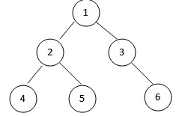
3. Iterative inorder

Slide 10
void treenode::iterativeinorder(node *root)
{
// Base Case
if (root == NULL) return; //empty tree
node* S1[10]; //1) Create an empty stack S.
int top=-1;
node *curr=root; //2) Initialize current node as root
for(::){
for(;curr;curr=curr->lc) S[++top]=curr; //3) Push the current node to S if not
//NULL and set current = current->left until current becomes NULL(repeat)
if(top>=0) curr=S[top--];
else break; //5) stack is empty then we are done.
cout<<curr->data;
curr=curr->rc;
}
}
3. Iterative inorder

Slide 11
void treenode::level_order(treenode* ptr)
{
int front=-1; int rear=-1;
treenode *Q[10];
if(!ptr) return; //empty tree
Q[++rear]=ptr;
do
{
ptr=Q[++front];
cout<<ptr->data<<" ";
if(ptr->leftchild) Q[++rear]=ptr->leftchild;
if(ptr->rightchild) Q[++rear]=ptr->rightchild;
}while(front!=rear);
}
4. Iterative levelorder

Slide 12
1. Push root to first stack.
2. Loop while first stack is not empty
2.1 Pop a node from first stack and push it to second stack
2.2 Push left and right children of the popped node to first stack
3. Print contents of second stack
// An iterative function to do post order traversal of a given binary tree
void postOrderIterative(Node* root)
{ if (root == NULL) return;
// Create two stacks
Node* s1[10]; int top1=-1; Node* s2[10]; int top2=-1;
// push root to first stack
S1[top1]=root; Node* node;
// Run while first stack is not empty
while (top1>=0) {
// Pop an item from s1 and push it to s2
node=s1[top1--]; s2[top2++]=node;
// Push left and right children of removed item to s1
if (node->left) s1[top1++]=node->left; if (node->right) s1[top1++]=node->right;
}
// Print all elements of second stack
while (top2>=0) {
node = s2[top2--]; cout << node->data << " ";
}
}

Slide 13
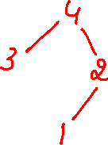
Copying a BT
5. copy
Copy(4) creates a temp node, copies 4 into it.
Calls ->lc=copy( )
Copy( ) creates a temp node, copies 3 into it. Calls ->lc=copy( NULL) //copy(NULL) call returns NULL
Calls ->rc=copy( NULL) //copy(NULL) call returns NULL
Calls ->rc=copy( )
Copy( ) creates a temp node, copies 2 into it. Calls ->lc=copy( ) //creates a node with value 1 and
//returns it’s address
Calls ->rc=copy( NULL) //copy(NULL) call returns NULL
4
3
3
3
3
4
2
2
2
1
2

Slide 14
Copying a BT
5. copy
treenode *treenode::copy(treenode *ptr)
{
treenode *temp;
if(ptr)
{
temp=new treenode;
if(ptr->leftchild) temp->leftchild=copy(ptr->leftchild);
if(ptr->rightchild) temp->rightchild=copy(ptr->rightchild);
temp->data=ptr->data;
return(temp);
}
return(NULL);
}

Slide 15
6. printAncestors
//If target is present in tree, then prints the ancestors and returns true, otherwise returns false.
int treenode::printAncestors(treenode *root, int target)
{
/* base cases */
if (root == NULL) return(0);
if (root->data == target) return(1);
/* If target is present in either left or right subtree of this node,
then print this node */
if ( printAncestors(root->leftchild, target) ||
printAncestors(root->rightchild, target) )
{
cout << root->data << " ";
return 1;
}
/* Else return false */
return 0;
}

Slide 16
treenode* treenode::parent(treenode *r, int ele)
{
if(r==NULL||r->data==ele)
return(NULL);
//Empty tree condition: root==NULL
//root->data==ele then root has no parent so, return NULL
If((r->leftchild!=NULL && r->leftchild->data==ele) || //ele is in leftchild of r
(r->rightchild!=NULL && r->rightchild->data==ele)) //ele is in rightchild of r
return(r);
treenode *res=parent(r->leftchild, ele);
if(res!=NULL) return(res);
res=parent(r->rightchild, ele);
return(res);
}
7. parent

Slide 17
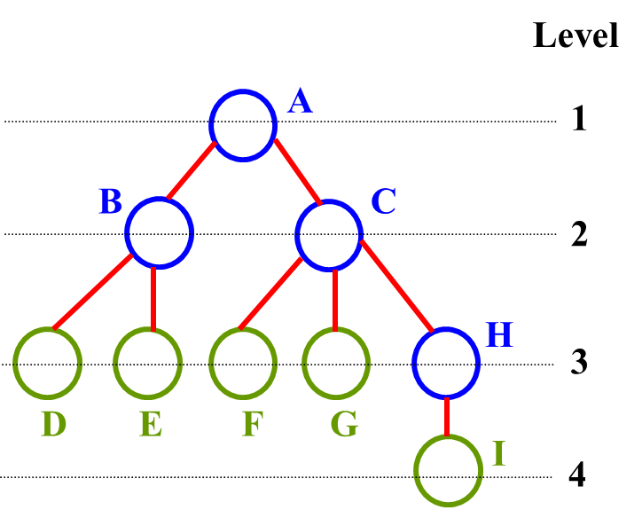
8. Height of a tree
The height (depth) of the tree is 4
Height (or depth): the maximum level of any node in the tree

Slide 18
int max(int a,int b)
{
int m=(a>b)?a:b;
return(m);
}
int treenode::FindHeight(treenode *r)
{
if(root==NULL) return(0);
return( max(FindHeight(r->leftchild), FindHeight(r->rightchild)) +1);
}
8. Height of a tree

Slide 19
Threaded Binary Tree
A threaded binary tree defined as follows:
"A binary tree is threaded by making all right child pointers that would normally be null point to the inorder successor of the node (if it exists), and all left child pointers that would normally be null point to the inorder predecessor of the node."

